Slide 1

Superpixel-based spectral classification for the detection of head and neck cancer with hyperspectral imaging
Hyunkoo Chung¹ , Guolan Lu ¹ , Zhiqiang Tian², Dongsheng Wang³ , Zhuo Georgia Chen³, Baowei Fei^{1,2,4,5,}
1The Wallace H. Coulter Department of Biomedical Engineering,
Georgia Institute of Technology and Emory University, Atlanta, GA;
2Department of Radiology and Atlanta, GA;
3Department of Hematology and Medical Oncology, Emory University, Atlanta, GA;
4Department of Mathematics & Computer Science, Emory University, Atlanta, GA;
5Winship Cancer Institute of Emory University, Atlanta, GA
Quantitative BioImaging Lab (QBIL)
Department of Radiology and Imaging Sciences

Slide 2
Motivation-Head and Neck cancer
40,000 new cases of head and neck cancer in the US in 2015.
This malignancy affects the cavities, glands, and sinuses in the head and neck area.
Over 90% of head and neck cancer are diagnosed as squamous cell carcinoma.

Slide 3
Current methods of tumor detection
Early detection is important to improve survival and diagnosis
Traditional diagnosis
Visual inspection
A biopsy
Problems: subjective
Difficulty choosing margin of cancer
Optical spectroscopy overcomes these limitations

Slide 4
Optics to detect malignant lesions
Optical spectroscopy
Detect malignant cancers using information from early biochemical and histological changes.
Disadvantages: only a point measurement method
Solution: Hyperspectral Imaging (HSI)
Hyperspectral imaging acquires continuous spectral bands by combining spectroscopy and imaging

Slide 5
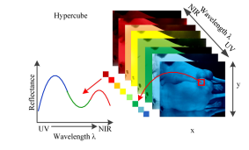
What is Hyperspectral imaging
Ability to capture large areas of tissue noninvasively without the use of a contrast agent – Label Free
Lu G, Fei B; Medical hyperspectral imaging: a review. J. Biomed. Opt. 0001;19(1):010901. doi:10.1117/1.JBO.19.1.010901.

Slide 6
Purpose of this study
Using hyperspectral images, develop a new processing method to identify the region of tumor tissue in mice.
Algorithm
Principal components
Superpixels
Support Vector Machine

Slide 7
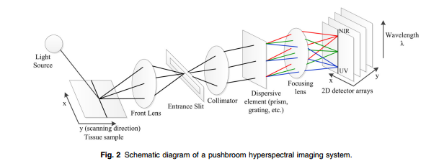
Experiments – Hyperspectral Imager
Reflectance images using Maestro in-vivo imaging system.
300 Watt Xenon light source
12 bit high-resolution charge-coupled device (CCD)
Solid state liquid crystal filter
Spectrally optimized lens.
Use a 390 x 435 ROI around tumor
Wavelengths 450 to 890 nm selected with 2nm increments
Autoexposure and reflectance mode

Slide 8
Experiments – Animal Model
A head and neck tumor xenograft model
Head and neck cancer cells (M4E) with green fluorescence protein (GFP)
11 female mice analyzed
Hyperspectral scans were acquired three weeks after tumor cell injection.
Anesthetized with 2% isoflurane in oxygen.
Mice #2

Slide 9
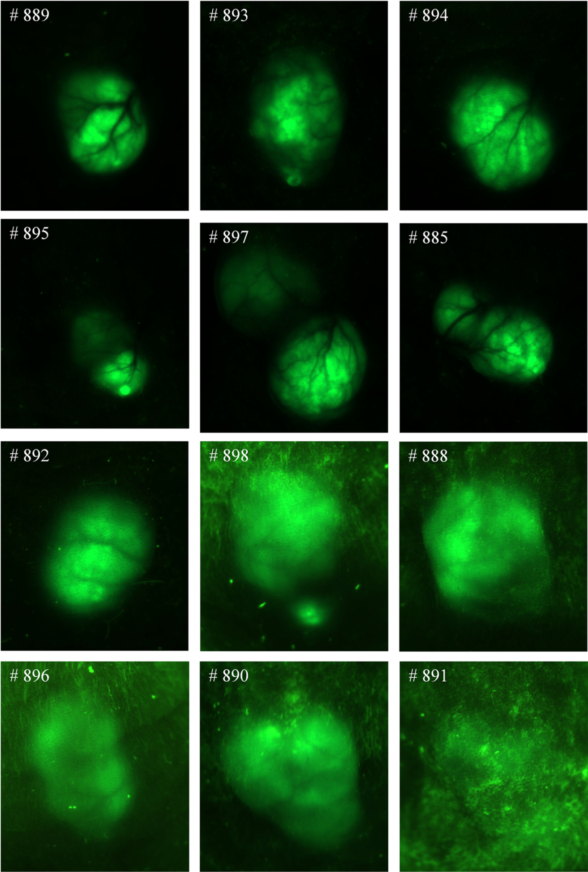
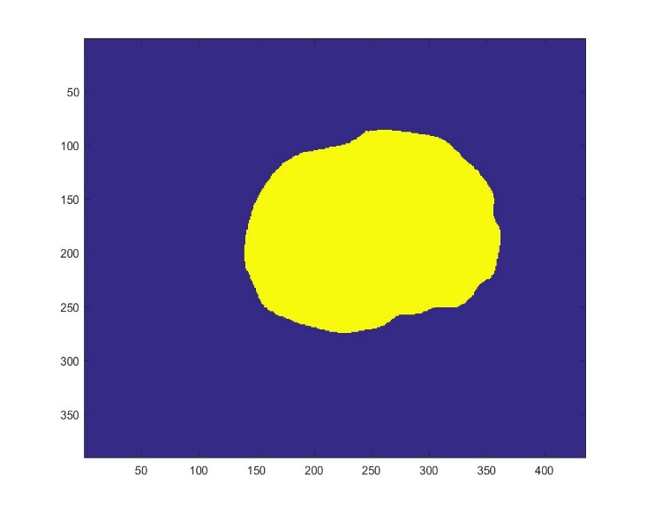
Experiments – Ground Truth
GFP fluorescence images were also acquired for the evaluation of cancer cell detection
Histological slides analyzed to validate cancer diagnosis
Lu et al. Spectral-spatial classification for noninvasive cancer detection using hyperspectral imaging J. Biomed. Opt. 0001;19(10):106004. doi:10.1117/1.JBO.19.10.106004.

Slide 10
Flow Chart
Feature 1
Raw Data
Pre-Processing
Feature 2
Post Processing
PCA
Superpixel
SVM
Feature N

Slide 11
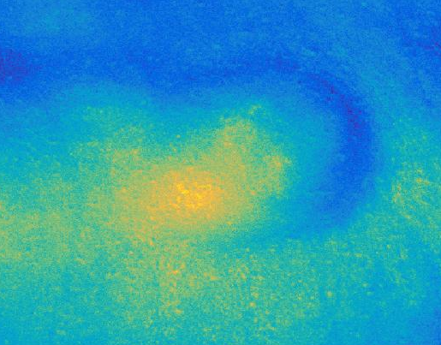
Preprocessing
A white reference image was acquired with a standard white reference board in the field of view.
A dark reference image was acquired with the camera shutter closed.
Reflectance(x, y, λ) = Raw(x, y, λ) − Dark(x, y, λ)
White(x, y, λ) − Dark(x, y, λ)

Slide 12
Principal Components
Principal component analysis (PCA)
Reduces the dimensionality
Applied to the pre-processed data before superpixel segmentation
Select the bands that that contain large variance in the data
Selected 2 Principal Components
Remove the step of manually choosing specific bands

Slide 13
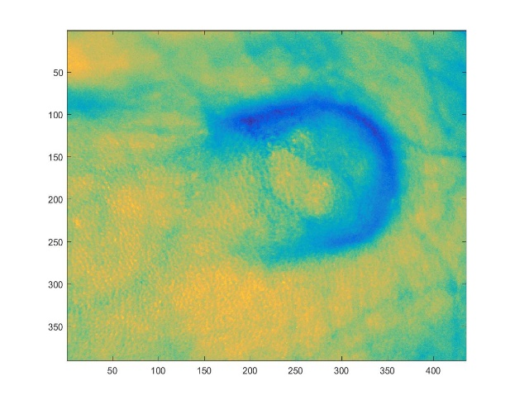
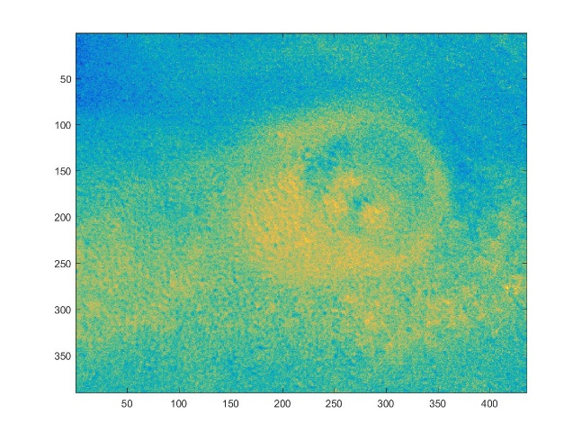
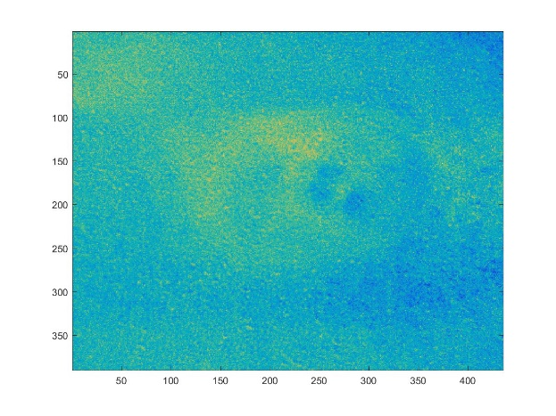
Principal Components
Principal Component 1
Principal Component 2
Principal Component 3

Slide 14
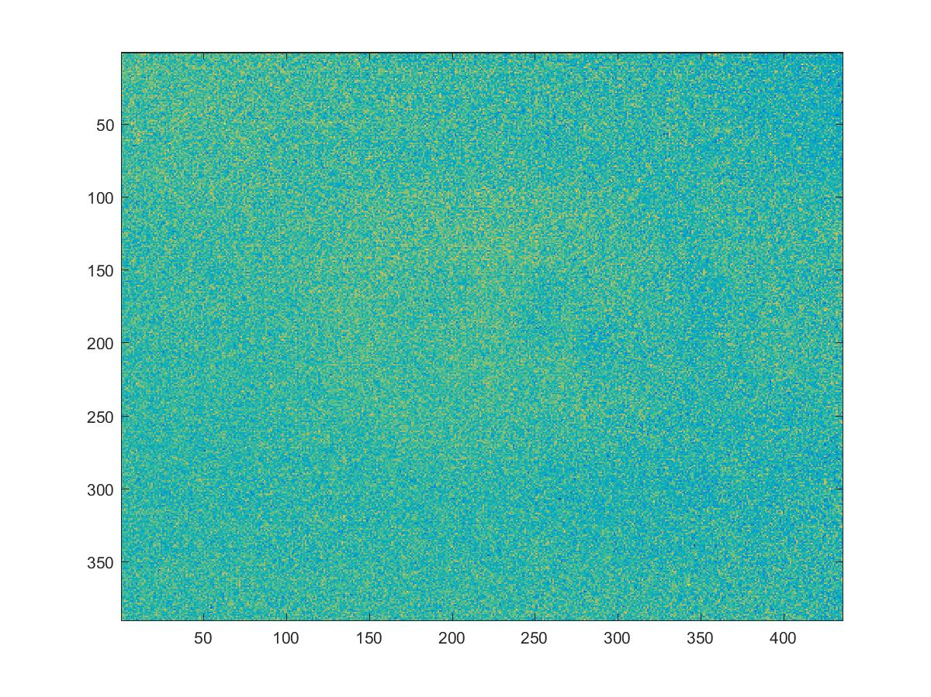
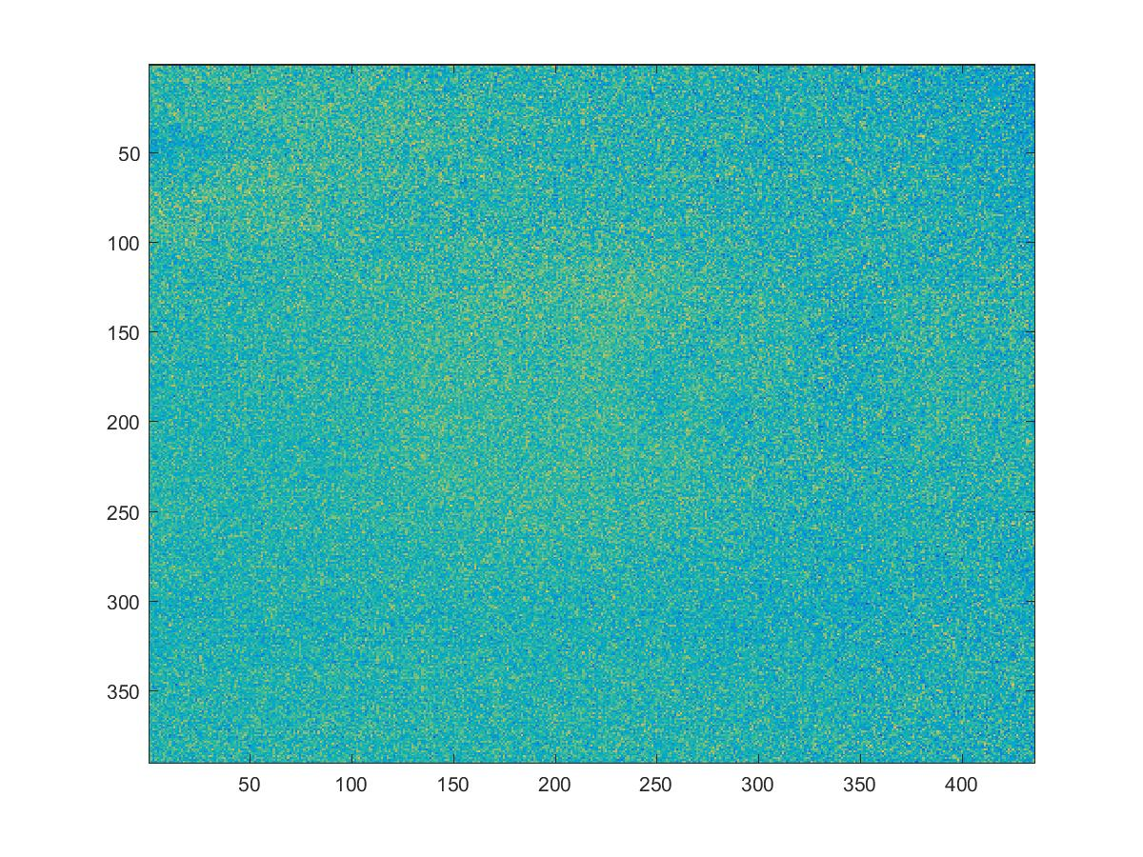
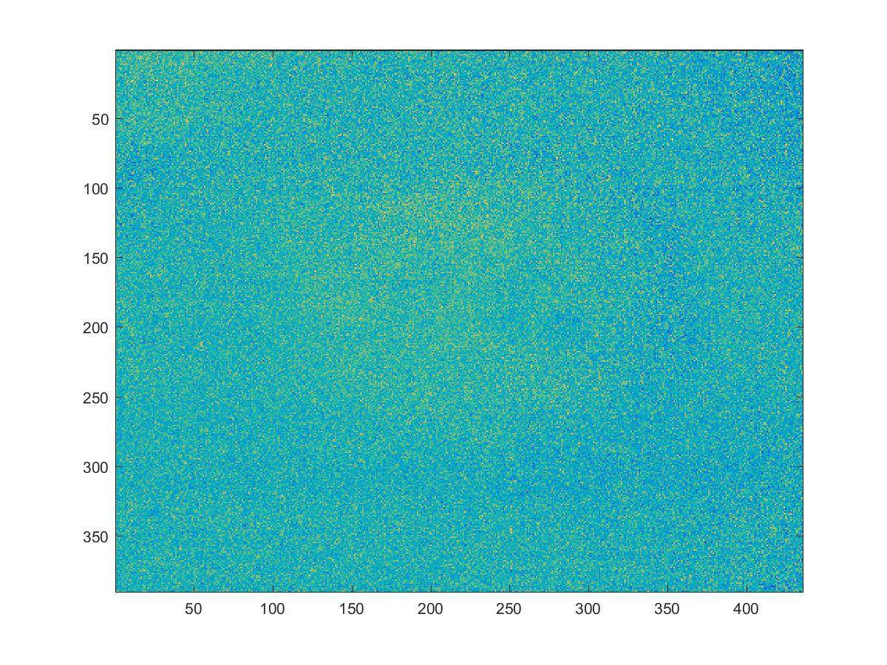
Principal Components
Principal Component 4
Principal Component 5
Principal Component 6

Slide 15
Superpixels (SLIC)
Superpixels algorithms combine pixels into meaning regions.
Simple linear iterative clustering (SLIC) technique.
Modified K means search
Superpixel Segmentation applied to principal components.
Achanta et al SLIC Superpixels Compared to State-of-the-Art Superpixel Method IEEEE Pattern Analysis and Machine Intelligence 2012

Slide 16
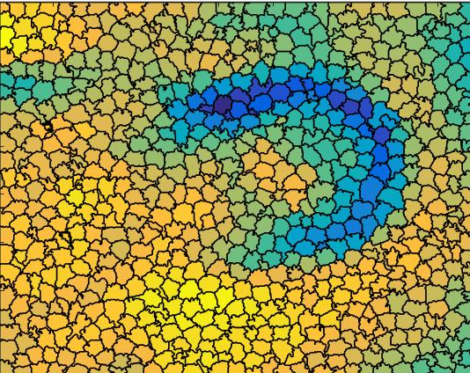
Superpixel Segmentation
SLIC Algorithm
170x decrease
169,650 Pixels
1000 Superpixels

Slide 17
Support Vector Machine Classifier
11 tumor-bearing mice
A leave-one out method
10 mice for training and one for testing

Slide 18
Results
 | Superpixel-PCA-SVM |  | SVM |  | PCA-SVM
Mice Number | Sensitivity | Specificity | Sensitivity | Specificity | Sensitivity | Specificity
1 | 0.84 | 0.91 | 0.41 | 0.73 | 0.72 | 0.82
2 | 0.99 | 0.84 | 0.77 | 0.71 | 0.90 | 0.77
3 | 0.96 | 0.85 | 0.47 | 0.73 | 0.80 | 0.78
4 | 0.69 | 0.89 | 0.30 | 0.64 | 0.65 | 0.71
5 | 0.99 | 0.77 | 0.55 | 0.72 | 0.88 | 0.72
6 | 0.99 | 0.84 | 0.79 | 0.80 | 0.95 | 0.79
7 | 1.00 | 0.91 | 0.88 | 0.75 | 0.89 | 0.75
8 | 1.00 | 0.84 | 0.64 | 0.70 | 0.94 | 0.74
9 | 0.98 | 0.72 | 0.45 | 0.64 | 0.76 | 0.69
10 | 0.81 | 0.92 | 0.60 | 0.77 | 0.78 | 0.88
11 | 0.93 | 0.84 | 0.49 | 0.71 | 0.81 | 0.78
Average | 0.93 | 0.85 | 0.58 | 0.72 | 0.83 | 0.77
18
Notes:
The results of the PCA-superpixel-SVM based classifier is shown in this table. For the result using two principal components and superpixels, the superpixel-PCA-SVM based classifier obtained the highest sensitivity and specificity when compared with PCA-SVM and only SVM classifier. The superpixel-PCA-SVM achieved a sensitivity of 93% and a sensitivity of 85%. Furthermore, a comparison of techniques with and without superpixel and PCA is shown. The superpixel-PCA-SVM based method improved the average sensitivity by 35% and average specificity by 13% compared to the only SVM classifier. Furthermore, the addition of the superpixel step improved the average sensitivity by 10% and average specificity by 8% when compared to the PCA-SVM classifier.

Slide 19
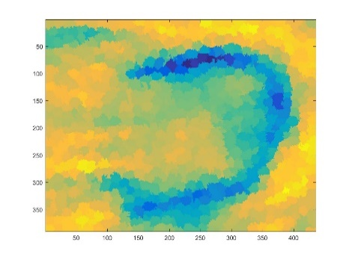
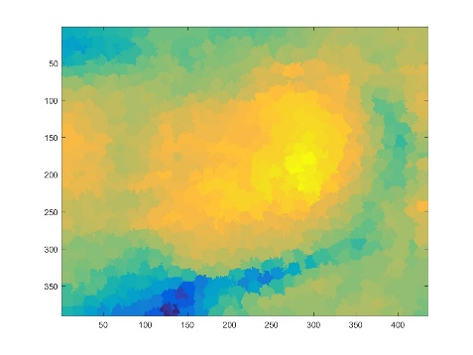
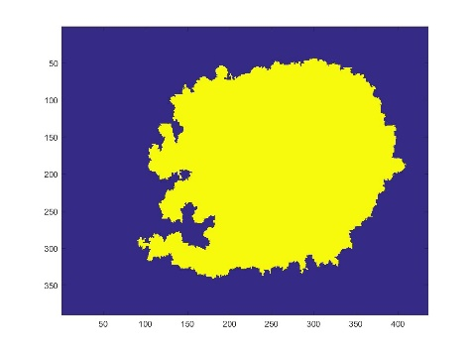
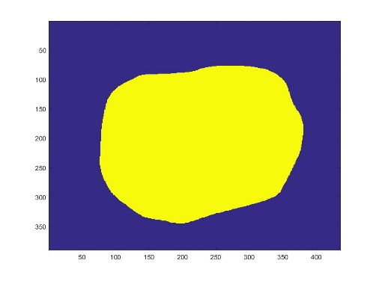
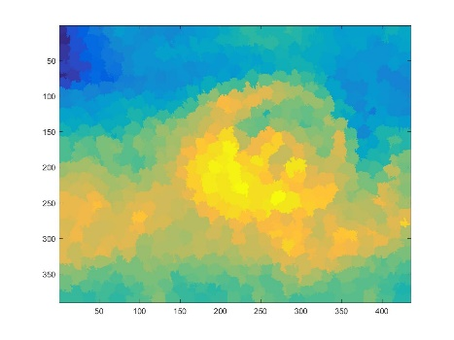
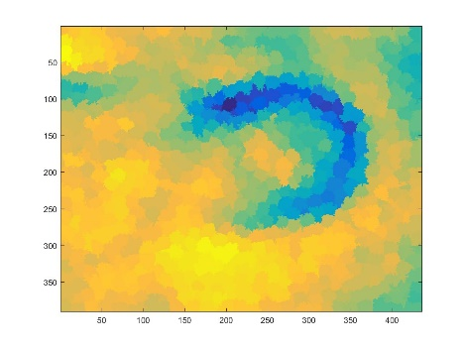
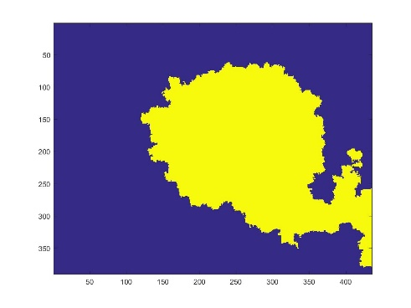
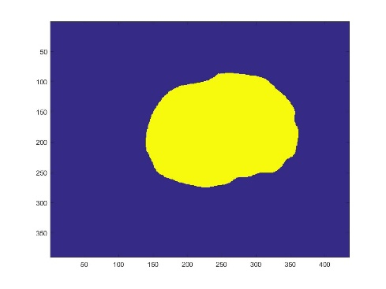
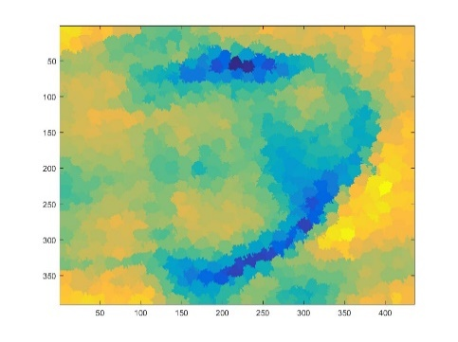
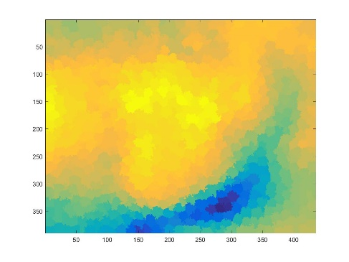
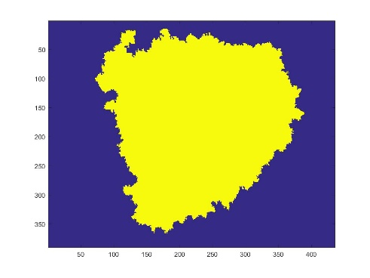
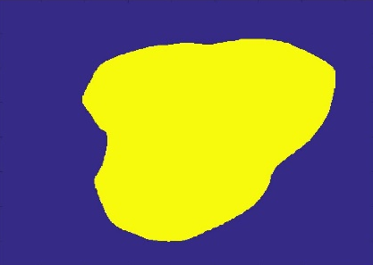
Results
Mice 1
Mice 2
Mice 7
PC1
PC2
Predicted
Ground Truth

Slide 20
Reduction in Computation Time
SVM pixelwise method
Train millions of pixels for classifier
390 x 435 images
450 to 890 nm wavelengths
Training and testing: ≥ 20 hours
Superpixel PCA-SVM based classification
2 Principal Components
1000 superpixels
Training: ≤ 15 minutes and testing: ≤ 1 min

Slide 21
Conclusion
Proposed a superpixel based classification method for hyperspectral image classification
Tested the method in a heck and neck cancer animal model
PCA and superpixel methods reduces the dimensionality of the dataset
We are testing the hyperspectral imaging method in head and neck cancer surgical specimens from 32 patients.

Slide 22
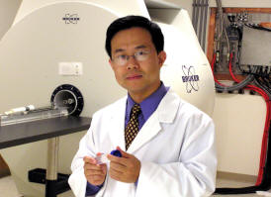

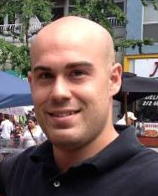
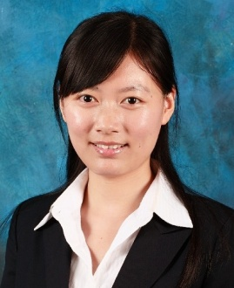
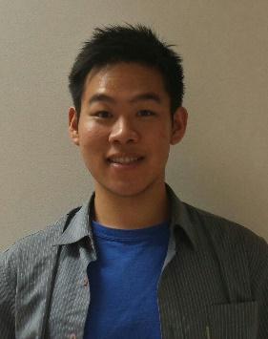
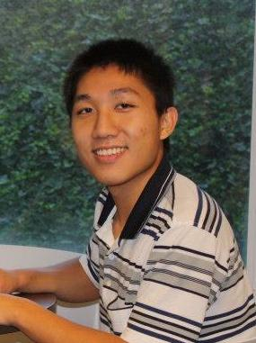
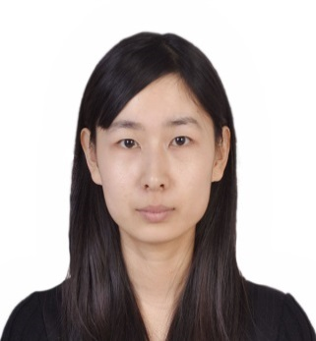
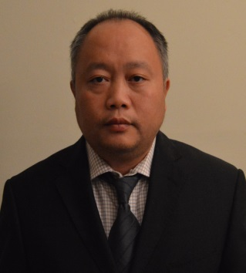
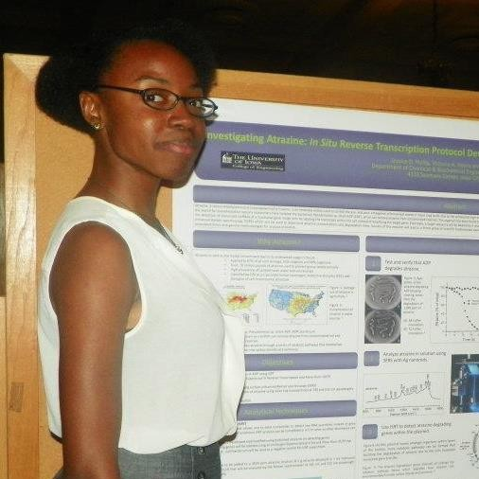

Acknowledgement
Quantitative BioImaging Laboratory (QBIL)
Funding Agency
Georgia Research Alliance (GRA)

Slide 23
feilab.org

Slide 25
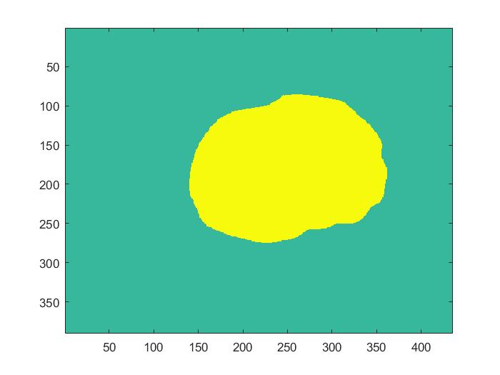
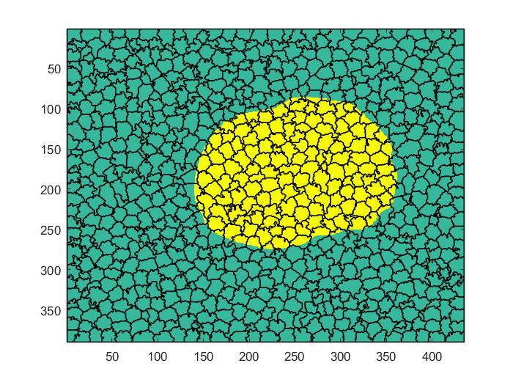

Superpixel Ground Truth
Original Ground Truth
Overlayed Superpixel Region
Superpixel Ground Truth

